Slide 1
Databases data compilation

Slide 2

Mirwalk

Slide 3
Publications
2011
2014
2018

Slide 4
Data source
The gene and miRNA dictionaries for human, mouse and ratwere compiled from several databases:
HUGO Gene NomenclatureCommittee (HGNC), Mouse Genome Database (MGD), Rat GenomeDatabase (RGD), gene-centered information at NCBI (Entrez Gene),Targetscan and miRBase.
e merged into syn-onym dictionaries
The informa-tion on diseases, organs, and OMIM disorders was extracted fromMeSH (Medical Subject Heading) and OMI
The keywords on proteins known to be involved in miRNA processing and cell lines were collected from PubMed database by readingthe publications

Slide 5
Targets
Genes
miRNAS
Pathways
Diseases
Organs
Cell lines
OMIM disorders
miRNA Processing Proteins (MPP)

Slide 6
Code/Algoritm
Perl
Watson–Crick complementary subsequences betweenmiRNA and gene sequences
miRWalk algorithm searches for seeds based on Watson–Crick complementarity, walking on the complete sequence of agene starting with a heptamer (seven nucleotides) seed from posi-tionS 1 and 2 of miRNA sequences.
miRWalk compares the identified miRNA bindingsites with the results obtained from eight established miRNA-tar-get prediction programs
e automated text-mining task in the downloaded ti-tles and abstracts from PubMed database against curated dictio-naries.

Slide 7
Text processing
first the automated text-mining searchmodule downloads all the available abstracts in XML (ExtensibleMarkup Language) format that contained keywords such as ‘micr-oRNA’, ‘miRNA’, ‘micro-RNA’, ‘micro_RNA’, ‘micro RNA’, ‘miR’ intheir title and/or abstracts. Thereafter, the keywords from curateddictionaries are detected in the texts of downloaded titles/ab-stracts (Name Entity Recognition, NER) by string matching scriptwith the help of Perl regular expressions. The identification ofnamed entities allows identifying miRNA terms linked with genes,diseases, organs, cell lines, pathways, OMIM disorders and proteinsknown to be involved in miRNA processing in an abstract. Thenthese relationships are processed and stored along with their Pub-Med identifiers as validated information under Validated Targetmodule of miRWalk database

Slide 8
Database
miRWalk is implemented as a relational database on a MySQLdatabase management system. The web interface of miRWalkdatabase is divided into two modules: (i) Predicted Target moduleand (ii) Validated Target module

Slide 9
API
Link from Outside
The miRWalk database has no API function yet. It is planned to create it together with a R package. For now it is only possible to link to a gene or mirna: http://mirwalk.umm.uni-heidelberg.de/{species}/{type}/{ID} for {species}: human, mouse, rat, dog, cow or fish for {type}: gene or mirna for {ID}: entrezIDs for genes and MIMAT-IDs for miRNAs Example: http://mirwalk.umm.uni-heidelberg.de/human/gene/595/

Slide 10
Updates
The database is completely updated twice a year. For this purpose, special scripts (in Python 3) were written for this task, which automatically download all necessary data, process them and save them in the corresponding formats and tables. The actual prediction of gene miRNA interactions using TarPmiR (the most time-consuming part) is then performed on a grid server and the results are finally integrated into miRWalk. Thus the complete database is updated every 6 months.

Slide 11

miRDB

Slide 12
Publications
2008
2015
2020

Slide 13
Database
wiki model
miRDB consists of two child databases and the related webinterfaces for (1) the retrieval of computationally predictedmiRNA targets, and (2) miRNA functional annotationswith a wiki editing interface. Perl and PHP were used to construct miRDB website, which links to a backend MySQLdatabase serve
miRDB presents afunctional catalog whose pages are organized by maturemiRNAs. Annotations on precursors are also presented byassociating to the corresponding mature miRNA

Slide 14
Target prediction
iRNA target prediction (Wang and El Naqa2008). Relevant features associated with miRNA targetbinding were identified by analyzing thousands of miRNAdown-regulated genes and these features were used to traina bioinformatics target prediction model with machinelearning
miRNA and target gene annotations.
he NCBI RefSeqdatabase for identification of 3′-UTR sequences. In brief,RefSeq sequences were downloaded from NCBI’s ftp site (8)and further parsed with the BioPerl program to obtain the3′-UTR sequences of the transcripts. Target prediction wasthen performed with the MirTarget algorithm, which wasdeveloped by analyzing high-throughput expression profil-ing data in a support vector machine framework (9). Unlikemost other prediction algorithms, MirTarget predicts bothconserved and nonconserved gene targets by treating tar-get site conservation as an important but non-required se-quence feature
new strategy to iden-tify functional miRNAs by combining computational anal-ysis with literature mining

Slide 15
PubMed literature mining

Slide 16
2020 updates
One unique aspect of the algorithm de-velopment process is the quality as well as the comprehen-siveness of the training data. Specifically, we have performeda large-scale RNA-seq study to globally profile the impacton target expression by individual miRNAs. To our knowl-edge, our RNA-seq profiling dataset, consisting of 1.5 bil-lion reads from 52 RNA samples, represents the largest ofits kind for miRNA target analysis. By focusing on tran-scripts that are downregulated by miRNA overexpression,we were able to discover and further quantify miRNA tar-geting features that are characteristic of target downregu-lation. On the other hand, we also analyzed public CLIP-ligation data (10,11) to identify paired miRNA/target tran-scripts that reside in the same miRISC complex.

Slide 17
Data Source
All database tables from miRBase were imported and linked to other tables in miRDB.mRNA sequences and annotation files were downloaded from theNCBI databases (Benson et al. 2007; Maglott et al. 2007). Transcript39-UTR sequences from human, mouse, rat, dog, and chicken wereparsed from the GenBank files with BioPerl (http://www.bioperl.org), and genome-wide miRNA target prediction was performedwith a newly developed bioinformatics tool, MirTarget2 (Wang andEl Naqa 2008)
Predicted transcript targets were then imported intomiRDB. Multiple transcripts from the same genes were mappedusing NCBI gene index files, and the transcript with the highesttarget prediction score was presented on the website. Target pre-diction results for all the transcripts were also available for batchdownload from the Data Download page on the miRDB website
Pathway data were downloaded from the PANTHER database(Mi et al. 2005). For each pathway, target prediction wasperformed to identify miRNAs that were significantly associatedwith this pathway. Statistical significance for pathway-specifictarget enrichment was calculated with hypergeometric test usingall genes in the genome as background

Slide 18

RFam

Slide 19
Publications
2003
2005
2005 (usage)
2009
2011
2012 (clustering)
2013
2015
2015 (usagex2)
2015 (molecules design)
2018
2018 (Analysis)
2021
2021 (R client)

Slide 20
2003
Rfam is a collection of multiple sequence alignments and covariance models representing non-coding RNA families. Rfam is available on the web in the UK at http://www.sanger.ac.uk/Software/Rfam/ and in the US at http://rfam.wustl.edu/. These websites allow the user to search a query sequence against a library of covariance models, and view multiple sequence alignments and family annotation. The database can also be downloaded in flatfile form and searched locally using the INFERNAL package (http://infernal.wustl.edu/). The first release of Rfam (1.0) contains 25 families, which annotate over 50 000 non-coding RNA genes in the taxonomic divisions of the EMBL nucleotide database.

Slide 21
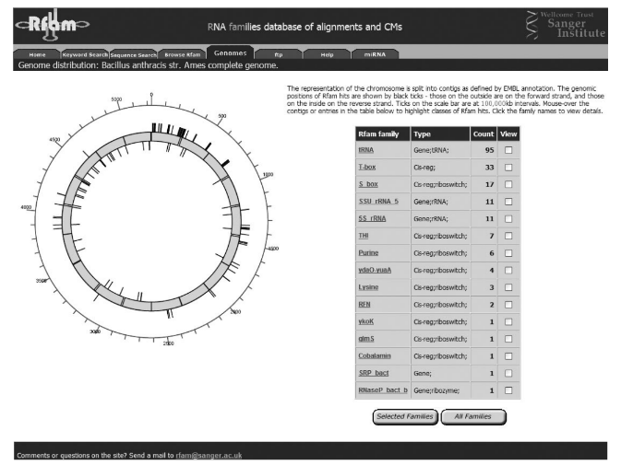
2004
The database has grown dramatically over the past two years:from 25 families annotating around55000 regions in the nucleo-tidesequencesdatabasesinrelease1.0,to379familiesannotatingover 280 000 regions in release 6.1. This growth is partly due to asignificant increase in scope. The evolution of some large genefamilies, such as miRNAs and snoRNAs, is constrained partiallyby inter-molecular base-pairing, and thus they do not conservesignificant sequence or secondary structure
This increased scope has led to the introduction of a limitedtype ontology, with the top-level types representing the threeclasses of structured RNA discussed above—‘Gene’, ‘Intron’and ‘Cis-reg’. The database currently contains 308 genefamilies, 69cis-regulatory elements and two self-splicingintrons. The type field provides one of the primary entry pointsfor family browsing and searching, enabling the user toquickly identify all snoRNA gene families for instance, orto find all riboswitches in the database.One of the primary uses of the Rfam database is to search forhomologues of known RNAs in a query sequence

Slide 22
2005
The Rfam Web servers allow the user to browse the repertoire of ncRNA families in theentire database or in a genome of interest; search the database using keywords, sequenceidentifiers or short nucleotide sequences; read a short description of the function offamily members; view structure annotated multiple sequence alignments; and view thetaxonomic distribution of family members. The protocol below describes some of theabove functions. The description here relates to use of Rfam 6.1 in August 2004.
A guide

Slide 23
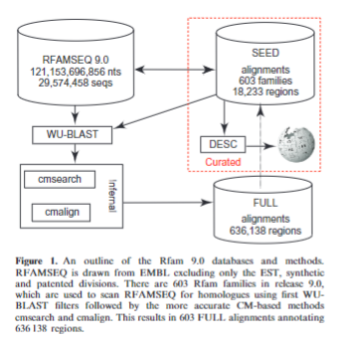
2008
All Rfam models are searched against an underlyingnucleotide sequence database, known as RFAMSEQ,which is derived from the EMBL nucleotide sequencedatabase (4). Prior to release 9.0, RFAMSEQ representedonly the various species sections of EMBL. These sectionscontained only sequences that were considered to be offinished quality and excluded sequences from manyimportant genomes. With release 9.0, RFAMSEQ hasbeen expanded to include the whole genome shotgun(WGS) and environmental sequence (ENV) divisions.These changes have increased the number of sequencesin RFAMSEQ by more than an order of magnitude(2 225 030 sequences in Rfam 8.0 versus 29 574 458sequences in Rfam 9.0
Sequence filters
One of the primary lim-itations of the Rfam annotation pipe-line has been the useof BLAST-based sequence filters, which are likely to com-promise search sensitivity. In order to address this issue atleast partially, NCBI-BLAST has been replaced with aWU-BLAST search, which has been tuned for high sensi-tivity and low sequence similarity.
Iteration of familie
In order to improve the species and sequence depth ofindividual Rfam families, more than 370 families havebeen expanded by an ‘iteration’ process, in which somesequences in the FULL alignment are chosen for promo-tion to the SEED alignment.
New graphical representations of secondary structureshave been added to the Rfam website,
The Rfam website now draws textual annotation of RNAfamilies directly from the scientific community, throughthe online encyclopedia Wikipedia. Any updates to rele-vant Wikipedia articles are downloaded on a nightly basisusing the MediaWiki AP

Slide 24
2010

Slide 25
2013
. Each family consists of a set ofRNA sequences which are believed to share a commonancestor. We provide a representative alignment for thefamily (termed the seed alignment) that has beenannotated with a consensus RNA secondary structure.A CM is built to describe the family, as well as a fullalignment which represents all matches of the CM to se-quences in our underlying sequence database. Ourprimary goal is to provide a comprehensive and accurateset of non-coding RNA annotations for genome annota-tion. Our alignments are also used extensively for trainingand benchmarking of other RNA sequence and structureanalysis tool
The procedure behind creating an Rfam family has beendetailed in our previous publications (2). Briefly:(1) a MSA, known as the seed alignment, with second-ary structure is produced by an Rfam curator orfrom a community submission;(2) a CM is created and calibrated from the seed usingInfernal’s cmbuild and cmcalibrate programs;(3) the Rfam sequence database, Rfamseq, is searchedwith BLASTN using query sequences from the seedalignment. Surviving subsequences that pass anE-value threshold are then re-searched with the CMto define final hit locations and scores;(4) an Rfam expert curator sets a bit-score threshold,above which sequences are considered to be truehomologues of the original seed sequences. Sequen-ces with a bit-score below the threshold are notincluded in the family; and(5) the Rfam curator adds selected novel and diversesequences resulting from the search to the seed align-ment and the process is repeated until no newmembers of the family are found
or Rfam 11.0, we have updated the underlying sequencedatabase from that used for Rfam 10.1 and Rfam 10.0.Rfamseq 11 is based on the standard and whole-genomeshotgun data classes from release 110 of the EMBL-Bank(January 2012). The previous version, Rfamseq 10, wasbased on the equivalent EMBL-Bank release from July2009. In this time, the Rfam sequence database hasgrown by34 million sequences; Rfamseq 11 is 1.6times as large as Rfamseq 10 and contains 89 111 824sequences.As part of the sequence update, sequences belonging tothe seed alignments are updated and all families arere-searched against the new sequence database. Theincreased sequence diversity has resulted in the majorityof families increasing in size. Outside of the four largestfamilies (tRNA, and the bacterial, eukaryotic andarchaeal SSUs), the average family roughly doubledfrom its Rfam 10.1 size, in terms of numbers of sequences

Slide 26
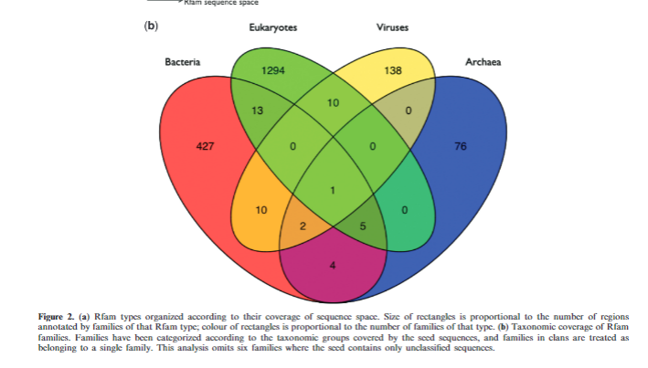
2013 cont
RESTful interfaceWe have added a ‘RESTful’ interface to many sections ofthe Rfam website. REST (or Representation StateTransfer) is a convention for building websites thatmakes it easier to interact with the website programmat-ically. Such an Application Programming Interface (API)allows users to write scripts to retrieve data and accessservices, rather than having to use a browser or to‘scrape’ pages to extract data. Most data can now beretrieved in a range of file formats, from JSON to XML.We also provide access to the single sequence search tool,allowing users to submit searches and retrieve results froma script or program. Full documentation for the RESTfulinterface can be found on our help pages at http://rfam.sanger.ac.uk/help#tabview=tab6, including sample Perlscripts that illustrate how it can be used.The Rfam BiomartA Biomart is a federated database system which aims tofacilitate exploration and interrogation of large biologicaldatasets (16). It has been adopted by many biologicaldatabases, such as Ensembl (17) and the Mouse GenomeDatabase (18). Our aim in creating a Biomart was to makeavailable sophisticated query technology in a user-friendlyformat; currently, the Rfam website only allows relativelysimple querying by (e.g.), family accession, general searchterm, taxonomy or family type. Search parameters arereferred to as filters, and the data requested are referredto as attributes. Available data filters and attributes areshown in Figure 3. The Biomart allows more complexFigure 3.Sunburst visualization of family taxonomy for RF01051, the cyclic di-GMP-I riboswitch. Users may select regions of taxonomic space anduse the controls on the left to download an alignment of their chosen subset of species.D230Nucleic Acids Research, 2013, Vol. 41, Database issueDownloaded from https://academic.oup.com/nar/article/41/D1/D226/1050811 by James Hardiman Library user on 07 February 2022

Slide 27
2014
UPGRADE TO INFERNAL 1.1
FAM 12.0: NEW FAMILIES AND CHANGES TO OURDATARfam 12.0 was released in September 2014. It contains 2450families and annotates 19 623 515 sequence regions from thestandard and whole genome shotgun data classes of ENArelease v110. Since the previous release (11.0), 18 familieshave been removed. Most of these modelled intronic regionsof long ncRNAs (lncRNAs), and two others were for fami-lies so short (21 and 22 nucleotides) that we were unable tobuild a CM capable of detecting homologues with statisticalsignificance in Rfamseq. We have added 260 new familiesin Rfam 12.0. The majority of the new families are bacte-
Annotating Rfam families with motifsUsing the motifs described above, the seed sequences ofeach Rfam family were annotated, providing an overviewof the motifs in a given family. Owing to the relatively smallsize of the motif models, it can be difficult to distinguishthe true instances of motifs from spurious matches. To alle-viate this, a series of heuristic rules for annotating familieswith RNA motifs was implemented. For each Rfam fam-ily, the seed sequences were made non-redundant (by fil-tering sequences more than 90% identical). These filteredseed sequences were scanned withcmscan(Infernal v1.1)against the motif CM library, using the gathering thresholdset for each motif

Slide 28
2017
UPDATING THE RFAM SEQUENCE DATABASETo build new families and identify instances of existingones, Rfam uses an aggregated sequence database calledRfamseq. PreviouslyRfamseqwas composed of the stan-dard (STD) and whole genome shotgun (WGS) sequencesets obtained from the ENA (9). Prior to release 13.0 themost recent version ofRfamseqwas generated based onENA release 110 (December 2011). Since then the size ofthe STD and WGS sets has grown almost tenfold from 0.27Tb to 2.2 Tb (ENA release 132, July 2017), and updatingRfamseqwith these data would make sequence searches andfamily building impractical. Furthermore, many of these se-quences represent redundant versions of the same or closelyrelated genomes and annotating all of them may not be use-ful. For example,Rfamseqv12 contained 26 Gb of humansequences which is eight times more than the length of refer-ence human genome, and 77 differentMycobacteriumtuber-culosisstrains. This redundancy in sequence led to redun-dant hits in the CM search results and made the analysis ofsuch results difficult.Sequence redundancy is a common problem for biologi-cal databases. To deal with it, the UniProt database recentlyswitched to annotating a non-redundant and regularly up-dated set ofreference proteomeswhich are selected using asemi-automated approach to cover the taxonomic spreadof species
R-scape (15) is a new method for testing whether covari-ation analysis supports the presence of a conserved RNAsecondary structure. In order to check the quality of Rfamstructures, we analysed all Rfam seed alignments with R-scape and added interactive R-scape visualisations to thesecondary structure galleries. For example, Figure5showsthe R-scape analysis of the S

Slide 29
2021
SYNCHRONISING MICRO RNA FAMILIES BETWEENRFAM AND MIRBASE
Based on miRBase v22, we have manually curated aninitial set of 1678 multiple sequence alignments. The re-maining∼300 families require more detailed considerationand curation, including merging and splitting, and will berevisited in a second phase.

Slide 30
2021
rfaRm:AnR client-sideinterfacetofacilitatetheanalysisoftheRfamdatabaseofRNAfamilies
https://pubmed.ncbi.nlm.nih.gov/33449976/

Slide 31
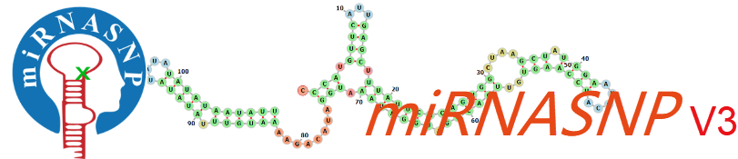
miRNASNP-v3

Slide 32
Publications
2015
2021

Slide 33
To reduce false positives, miRNASNP-v3 adopted the combination of two popular tools, TargetScan v7.2 and miRmap v1.1 (25–27), to determine the miRNA target binding sites
miRNASNP-v3 built useful modules for users to browse and explore the effects of SNPs/DRVs on the alterations of miRNA-target binding through multiple approaches

